Slide 1

Artificial Intelligence for Business Decisions and Transformation
CSCN8030 - Spring 2024 - Section 2
Sprint 5 - Demo
July 22, 2024
Group 4 - Members:
Krishna Kumar, Hemasree
Shijin, Jency
Fernandez, Arcadio
Professor:
Glaucia Melo dos Santos, PhD

Slide 2

Our focus
User Interest Profiling for TikTok Reviews
Project Idea: Develop a system to automatically identify and classify user interest profiles based on user reviews.
Techniques: Supervised learning, sentiment analysis
Outcome: This will help in understanding user preferences, improving content recommendations, and aiding influencers in tailoring their content strategies

Slide 3
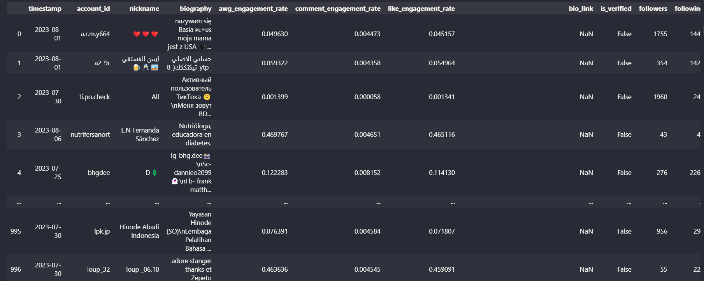
Data

Slide 4
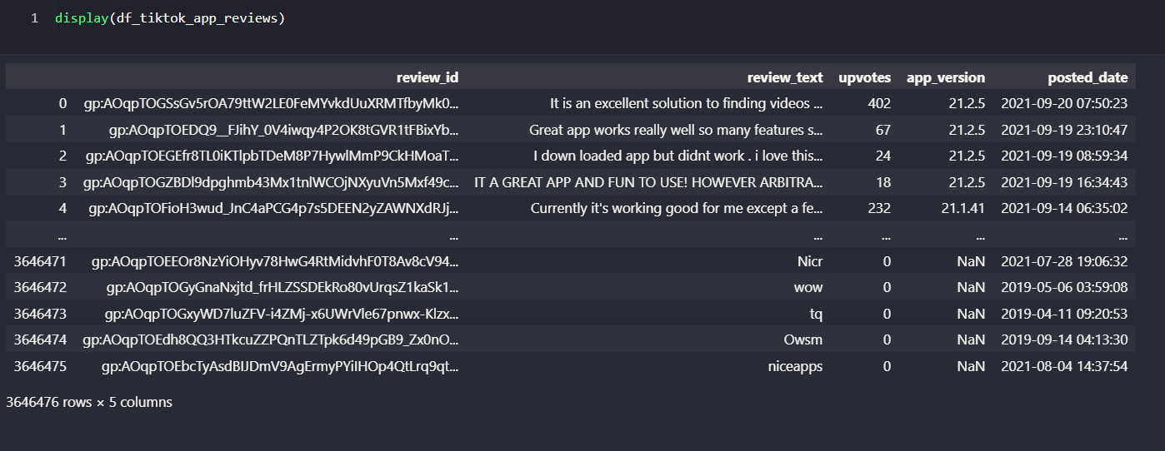
Data

Slide 5
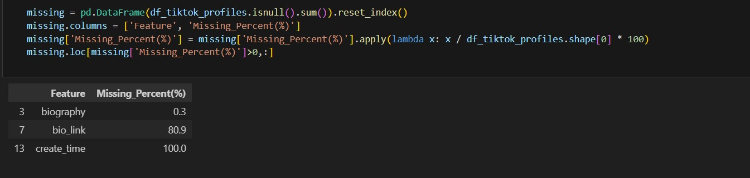
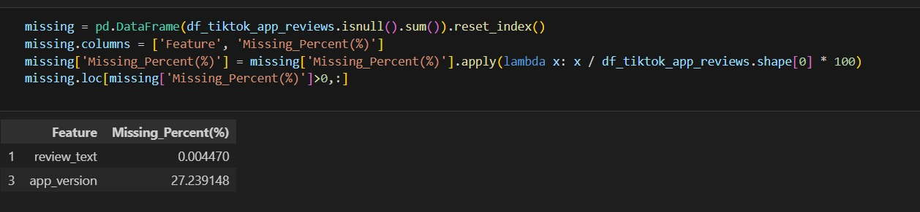
2. Clean the data by handling missing values, correcting data types, and ensuring data consistency.
There are around 3 Million user reviews

Slide 6
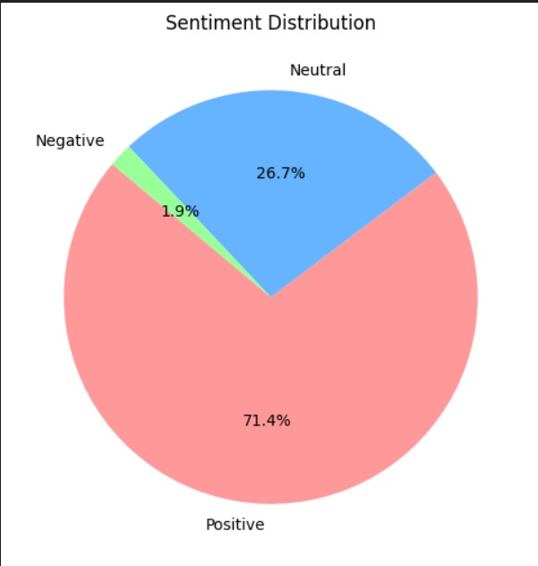
3. Exploratory Data Analysis

Slide 7
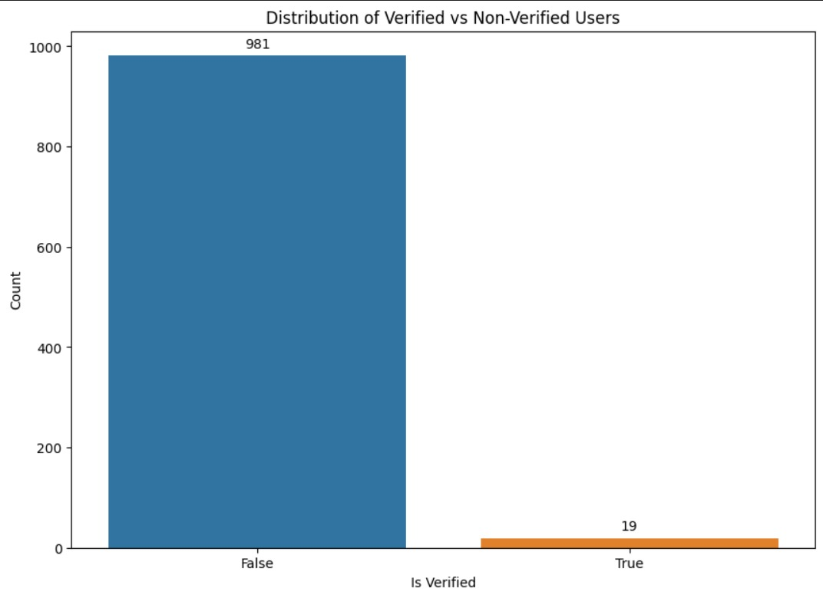
3. Exploratory Data Analysis

Slide 8
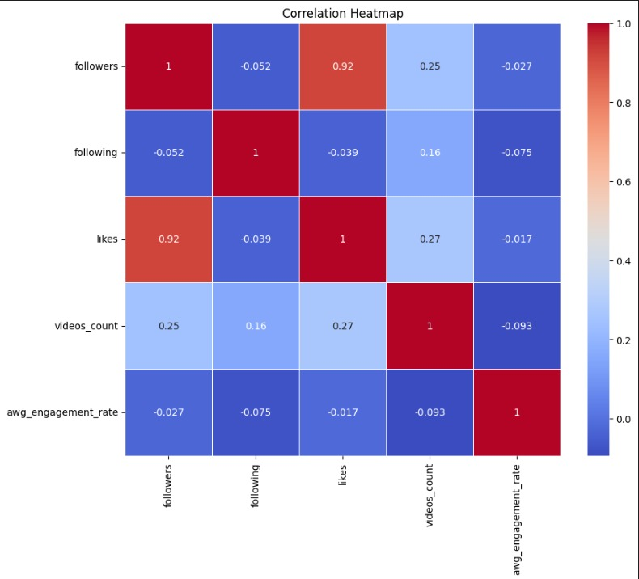
3. Exploratory Data Analysis

Slide 9
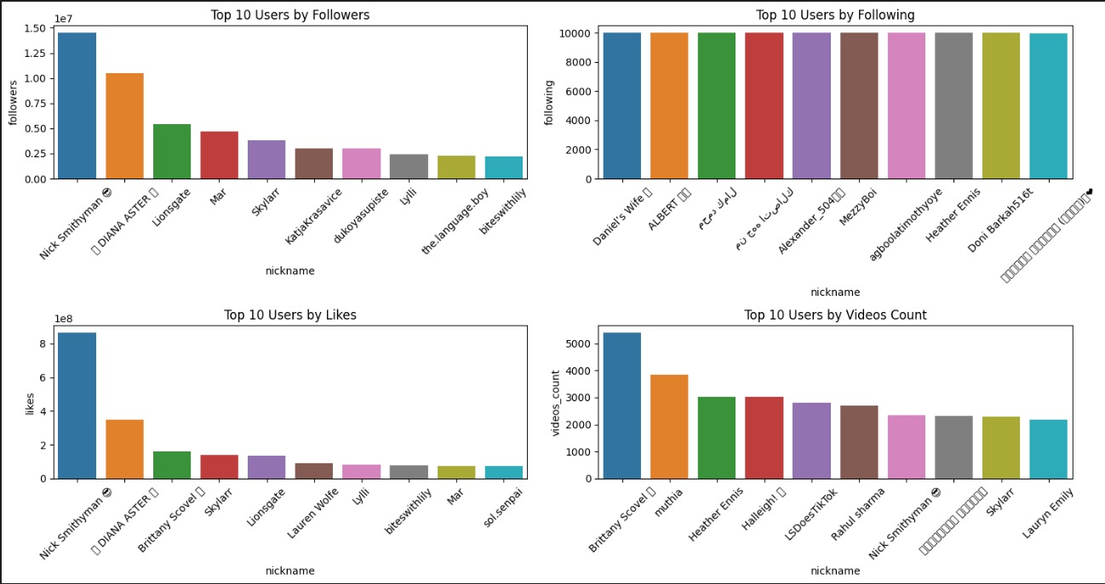
3. Exploratory Data Analysis

Slide 10
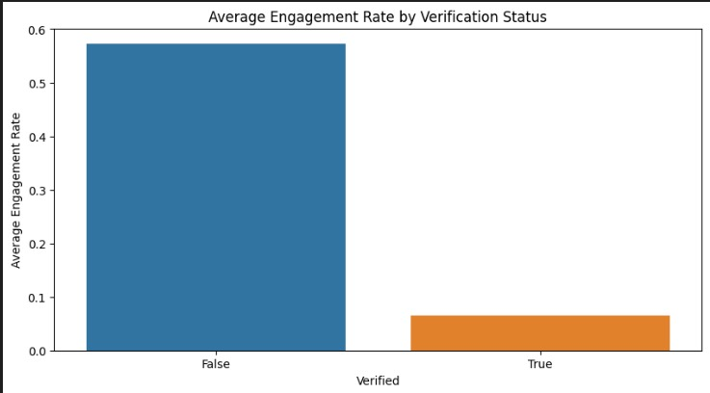

Slide 11
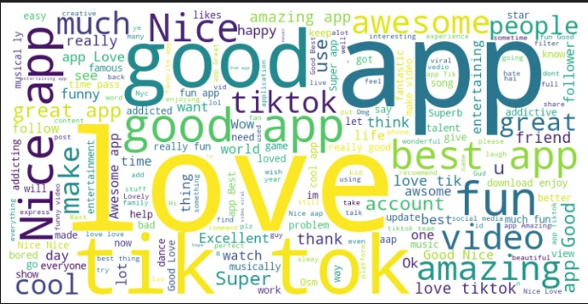
3. Exploratory Data Analysis

Slide 12
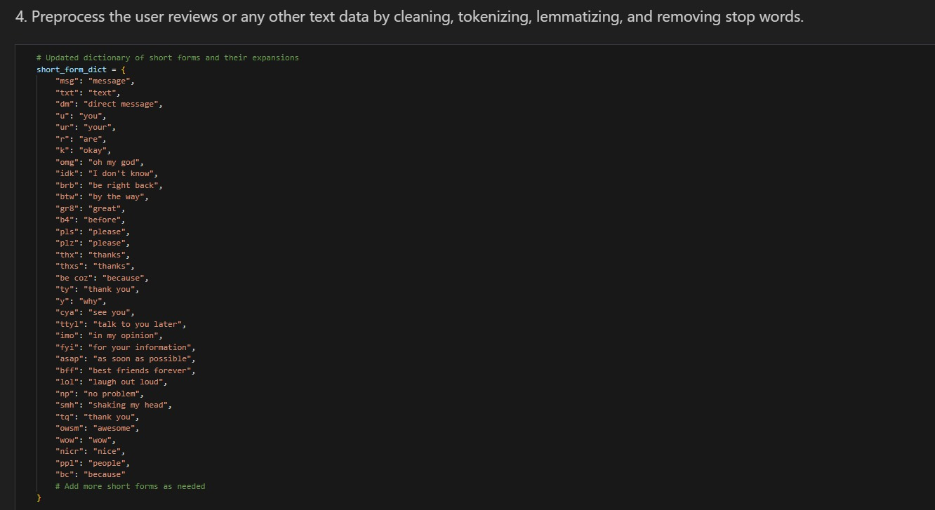
4. Preprocess the user reviews or any other text data by cleaning, tokenizing, lemmatizing, and removing stop words.

Slide 13
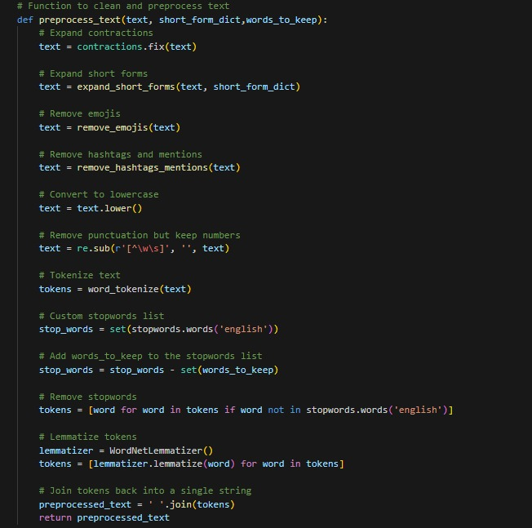
4. Preprocess the user reviews or any other text data by cleaning, tokenizing, lemmatizing, and removing stop words.

Slide 14
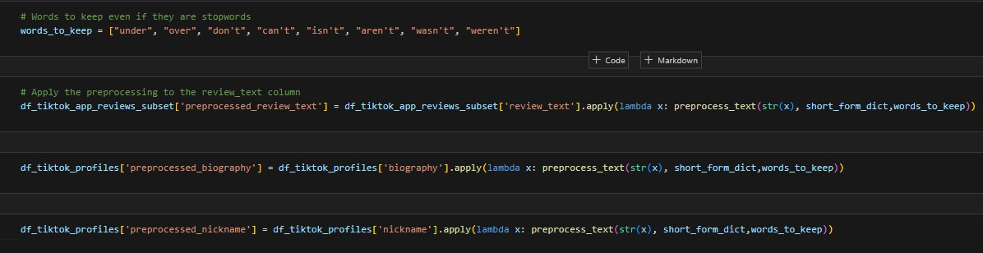
4. Preprocess the user reviews or any other text data by cleaning, tokenizing, lemmatizing, and removing stop words.

Slide 15
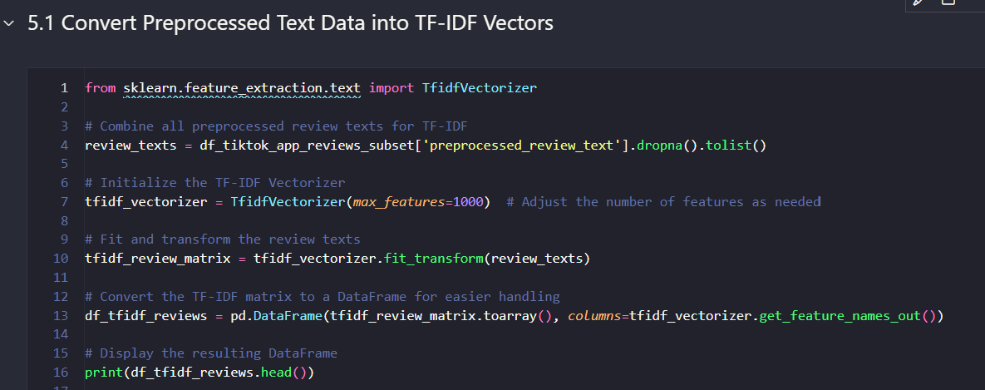
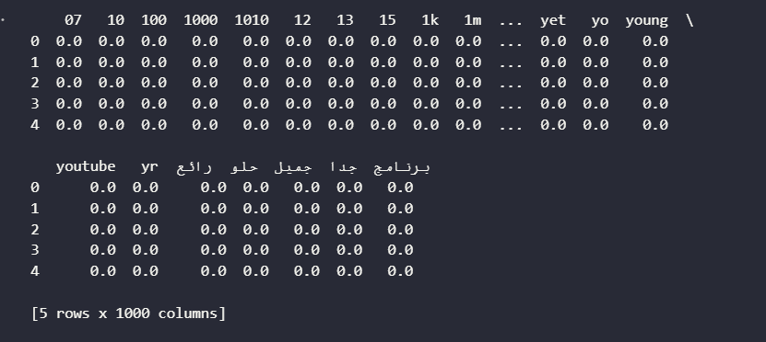
5. Convert the preprocessed text data into numerical representations using text embeddings such as BERT, FastText, or TF-IDF.
- TF-IDF is the fastest and most efficient for large datasets when you do not need deep contextual information.
- FastText offers a balance between speed and context but is slower than TF-IDF.
- BERT provides the most detailed and context-aware embeddings but is the slowest due to its computational complexity.

Slide 16
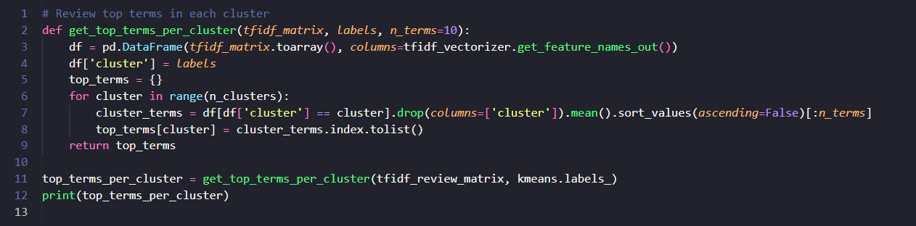
6.Perform Clustering to Group Reviews
6.1. Perform Clustering to Group Reviews
{0: ['nice', 'app', 'best', 'amazing', 'fun', 'awesome', 'great', 'super', 'cool', 'love’],
1: ['aap', 'nice', 'good', 'best', 'love', 'amazing', 'tok', 'tik', 'like', 'super’],
2: ['good', 'app', 'really', 'apps', 'nice', 'fun', 'tiktok', 'love', 'video', 'funny’],
3: ['like', 'app', 'tiktok', 'much', 'video', 'tik', 'tok', 'really', 'good', 'please’],
4: ['love', 'app', 'tiktok', 'much', 'tik', 'tok', 'fun', 'amazing', 'musically', 'best']}

Slide 17
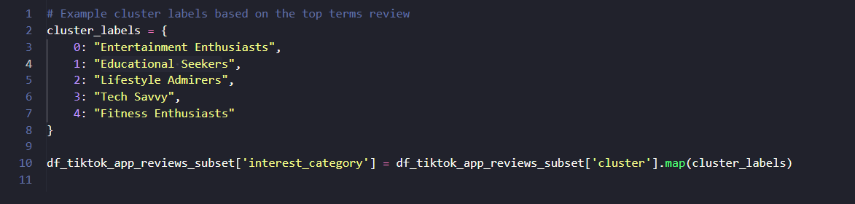
6.Perform Clustering to Group Reviews
6.2. Review and Label Clusters

Slide 18
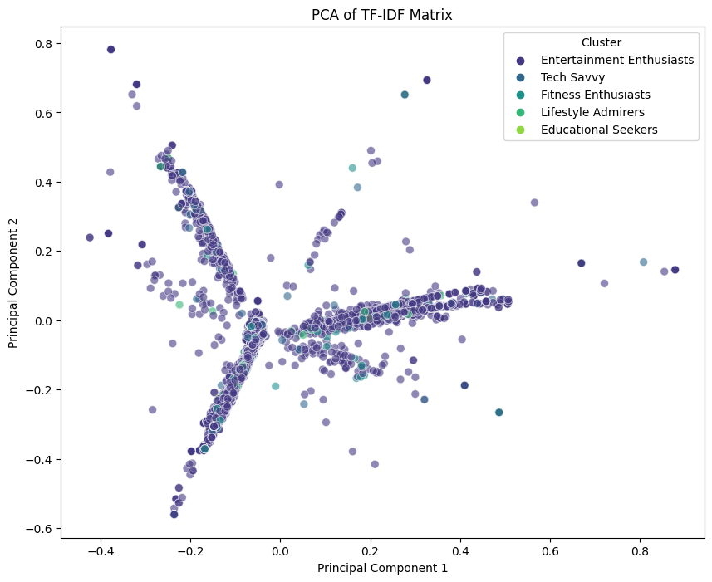
6.Perform Clustering to Group Reviews
6.3. Plot the clusters

Slide 19
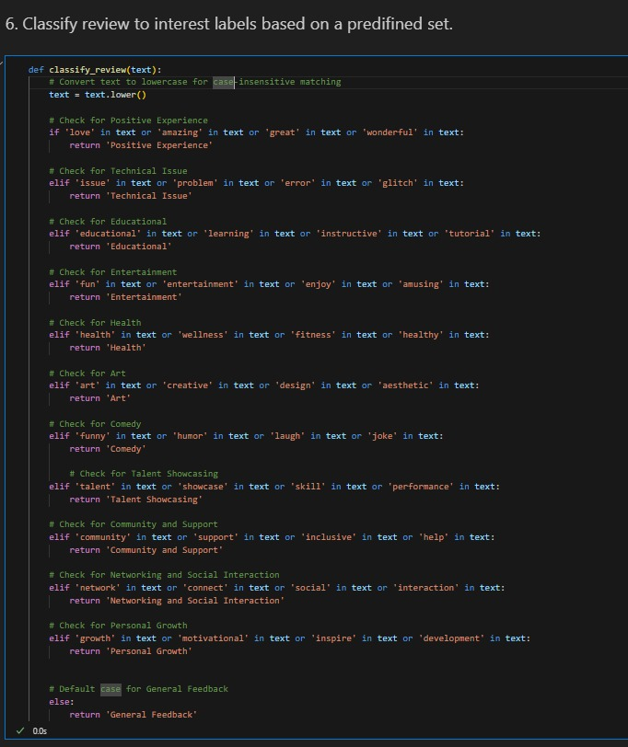
6.4. Manual labeling of User reviews

Slide 20
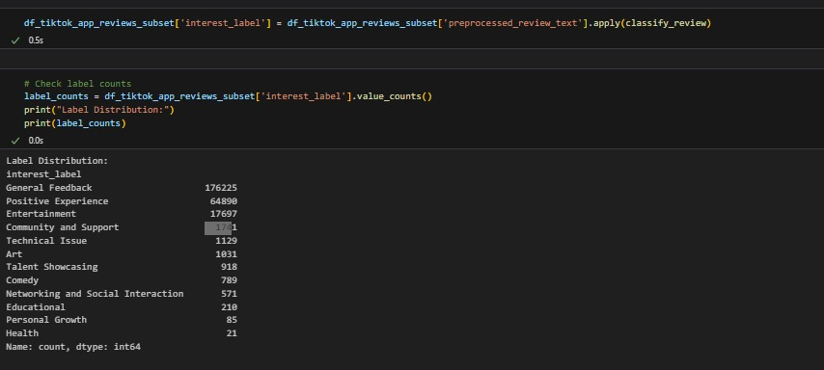
6. Manual labeling of User reviews

Slide 21
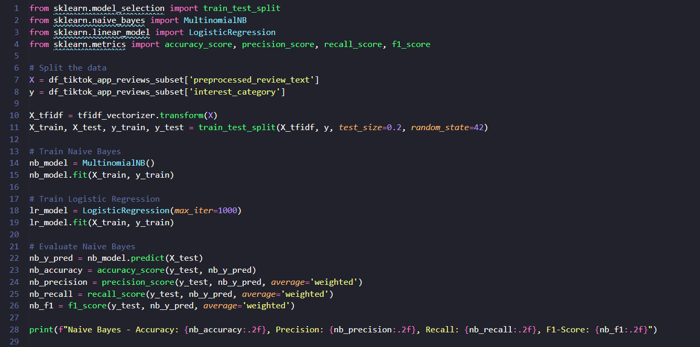
7. Train a Supervised Model
Now that you have labeled data, you can train a supervised model (Naive Bayes) to predict these labels.

Slide 22
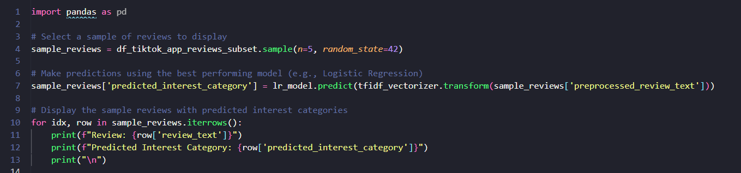
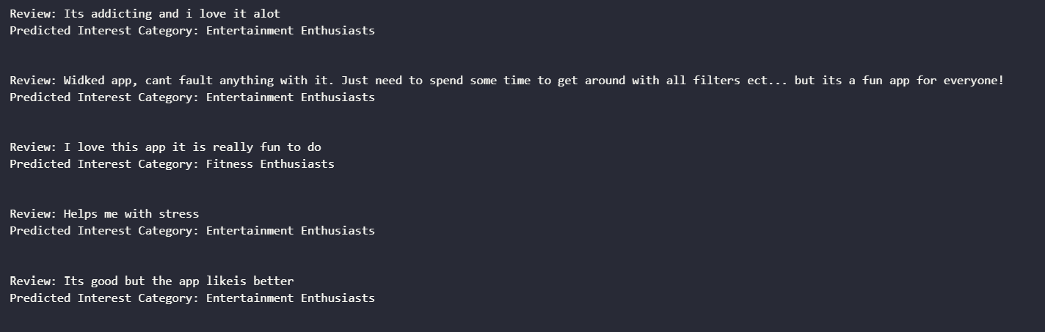
7. Train a Supervised Model
Make Predictions on a Subset of Reviews
Next, let's make predictions on a subset of the data and display some reviews with their predicted categories:

Slide 23
8. Next Steps
Currently we used Clustering and manual method for arriving at labels/user interest categories which doesn’t seem to provide meaningful results.
As a next step we are going to use pre-trained model such zero-shot-classification for annotating the dataset into user interest profiles and use it for training the model.
We used TF-IDF vectorizer for feature extraction because it was fast and efficient for large datasets but it doesn’t provide deep contextual information. So, we will use BERT embeddings in the future

